Slide 1
C# .NET CORE - Technology that has bright future

Slide 2

Vanik Hakobyan
Work - .NET Software Enginner at BetConstruct
Study - YSU IAM Computer Sciences
Linkedin - https://www.linkedin.com/in/VanikHakobyan
Github - https://github.com/VanHakobyan
Codefights - https://codefights.com/profile/VanHakobyan

Slide 3
Things about C# and .NET Core proving me right
Easy to learn
Modern language features
Versatility. web, mobile, server, desktop applications, game development
High-quality developer tools
Generalization of skills
.NET Core is an open source framework

Slide 4

Easy to learn
Very easy to switch from one language to C #
Pluralsight - Excellent training content
Microsoft Virtual Academy - Free Video Tutorials
Microsoft Getting Started with C# - Free interactive tutorials

Slide 5
Modern language features
Strongly typed
High-quality class libraries
Asynchronous programming - async / await
Garbage collection, automatic memory management
LINQ - Language Integrated Query
Package Management
Common binary files for different platforms and frameworks
Easy to use frameworks for creating MVC web applications and REST APIs.

Slide 6

Versatility: web, mobile, server, desktop applications …
Web development – ASP.NET MVC, ASP.NET WEB API
Mobile development – Xamarin
Background services – NT Service
Desktop applications – WinForms, WPF, UWP
Game development - Unity

Slide 7

High-quality developer tools
Visual Studio
Visual Studio Code (Cross platform)
JetBrains – Resharper, dotPeek

Slide 8

Generalization of skills
.NET has a very good collection of base libraries
Newtonsoft - Popular high-performance JSON framework for .NET
Entity Framework and MVC

Slide 9

.NET Core is an open source framework
Now everyone on GitHub can view, edit and contribute to it.
F12 People are amazed.

Slide 10

The core is equipped with Agile Development Capability
Мodular infrastructure
Faster upgrade platform

Slide 11
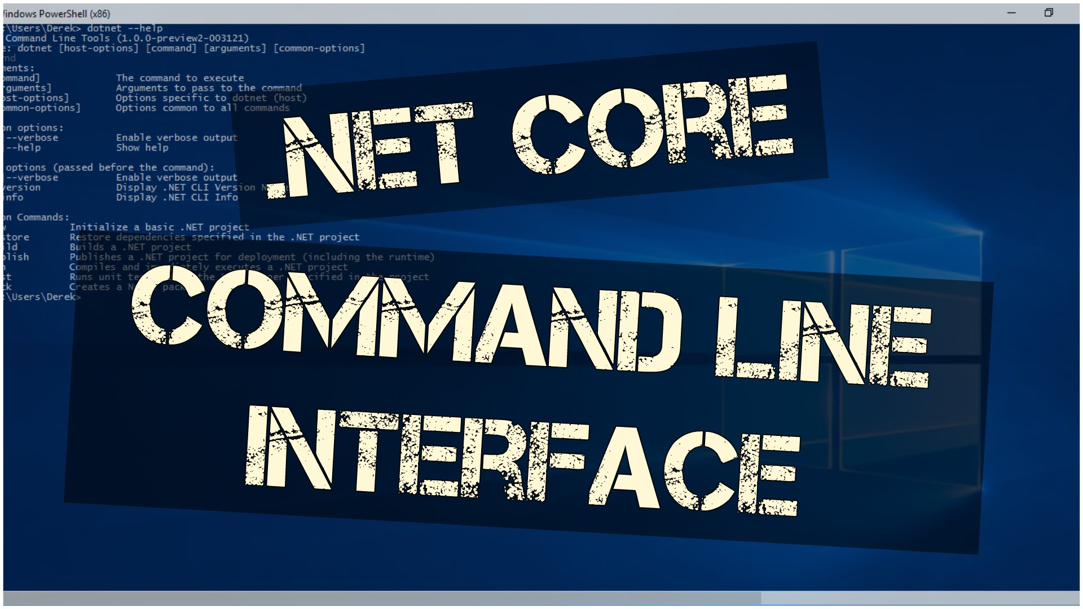
Command line interface
All product scenarios can be executed on the command line

Slide 12

Still in development
.NET Core 1.1
.NET Core 2.0 - also supports Visual Basic
.NET Core 2.1
"In a couple of years .NET Core will push Java from the enterprise solutions market“ - Jon Skeet author book “C# in Depth”

Slide 13
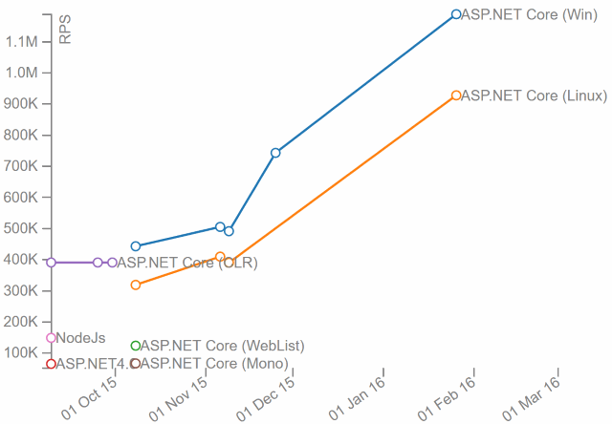
ASP.NET Core Requests Served Per Second
Exceeds 1.15 Million request/s

Slide 14
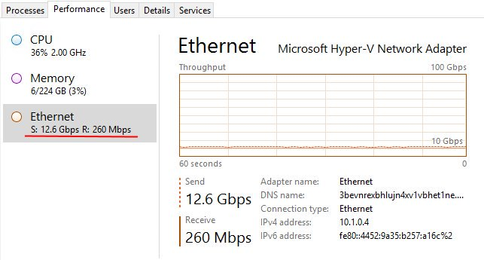
More than 12.6 Gbps of Throughput

Slide 15
In Bonuse. .NET core 2.1 released
New platform support, such as: Ubuntu 18.04, Alpine, ARM32.
Chip support follows: x64, x86, ARM32 on Linux
Now has a new deployment and extensibility mechanism for tools.
Runtime Performance Improvements
Networking Performance Improvements
New Cryptography APIs
Build Performance Improvements

Slide 16
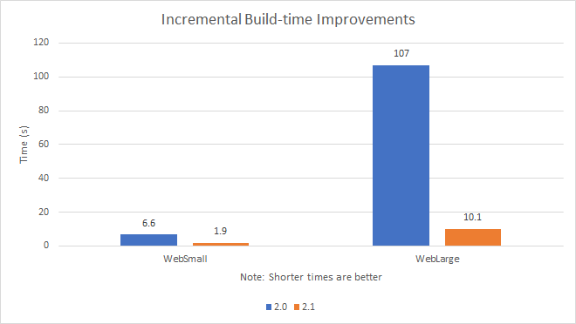
Build Performance Improvements
The image refers to the 2.1.300 SDK version.
These benchmarks were produced from projects at mikeharder/dotnet-cli-perf.

Slide 17



